Slide 1
WorldBank/Bedrock in Collaboration with CodeAnt Training 2024/2025: Week 11/12 Assessment on Power BI
Showing report of Adidas US Sales Data Analysis for year of 2020 and 2021
Done and Presented by: Ekpendu Franca

Slide 2
TABLE OF CONTENTS
Project Schedule: About the project
Business/Meeting Objectives
Project timeline
Analysis and Dashboards
Conclusion/Recommendations
Ask me any question
Done and Presented by: Ekpendu Franca

Slide 3
Project Schedule: About the Project
The project “Adidas US Sales Dataset” covers some certain products from Adidas Company featuring some states, Cities, regions and Retailers for period of 2020 and 2021 as a whole.
Done and Presented by: Ekpendu Franca

Slide 4
Business/Meeting Objectives
The objectives that I adopted on assessment include:
What are the Top 5 States that yield Operating Profits
Which of the Regions did we have least sales and why
Which of the products yielded the highest earning
Which retailer should we give incentive more than the other
Which year did we make the highest sales and why
Which operating margin provides the highest operating profit
What was the highest sales method and there top regions
Done and Presented by: Ekpendu Franca

Slide 5
Project Timeline
It only took roughly two weeks to cover this assessment which Start from 6th of February, 2025
Done and Presented by: Ekpendu Franca

Slide 6
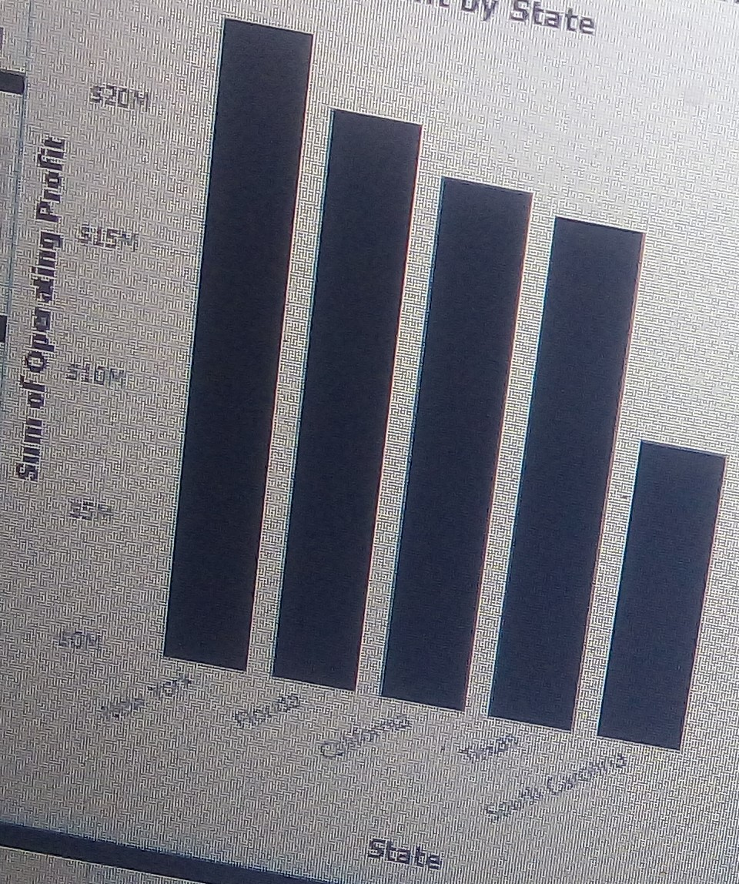
Analysis and Dashboards
What are the Top 5 States that yield Operating Profits
The analysis shows that the five states that has operating profits are New York (with sum operating profits of 23,329,824.07), Florida (sum of operating profit of 20,926,200.92), California(sum of operating profits of 19,301,170.4), texas (sum of operating profit of 18,688,204.35) and south Carolina(sum of operating profits of 11,324.236.39).
Section 1:
Done and Presented by: Ekpendu Franca

Slide 7
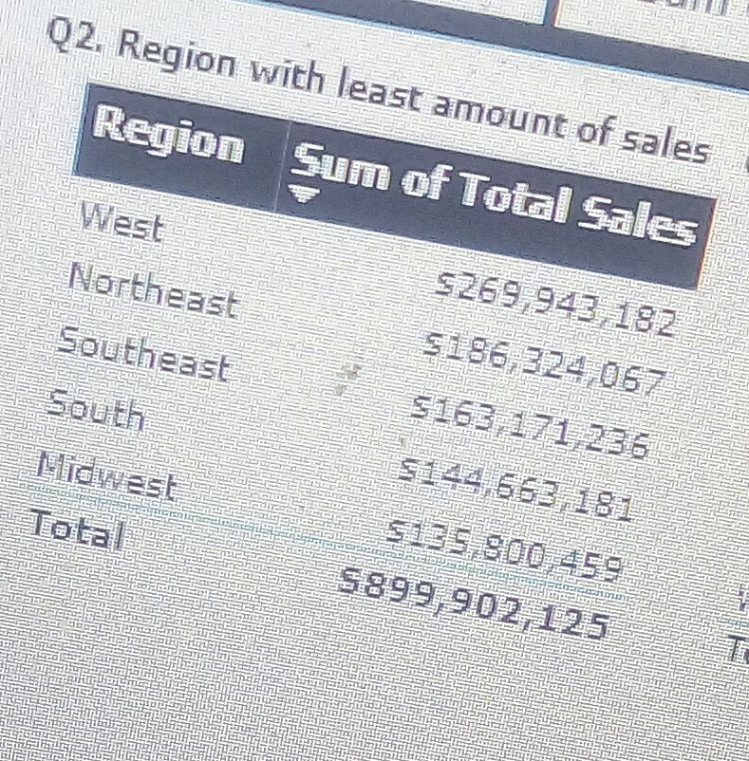
Analysis and Dashboards
Section 2:
Which of the Regions did we have least sales and why
Result shows that Midwest that has least sales because they operate in low sales outlet. It look like there is no much gateways through which they connected to their targeted audience or customers.
Done and Presented by: Ekpendu Franca

Slide 8
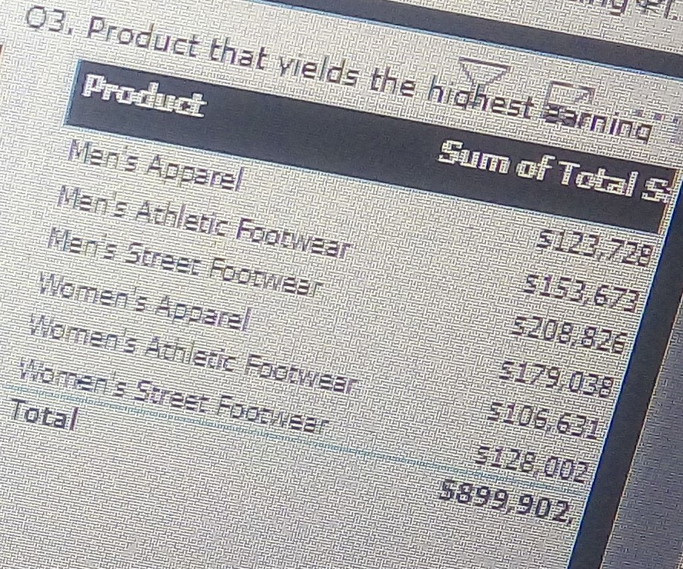
Analysis and Dashboards
Which of the products yielded the highest earning?
Result shows that Men’s Street Footwear has highest earning about $208,826
Section 3:
Done and Presented by: Ekpendu Franca

Slide 9
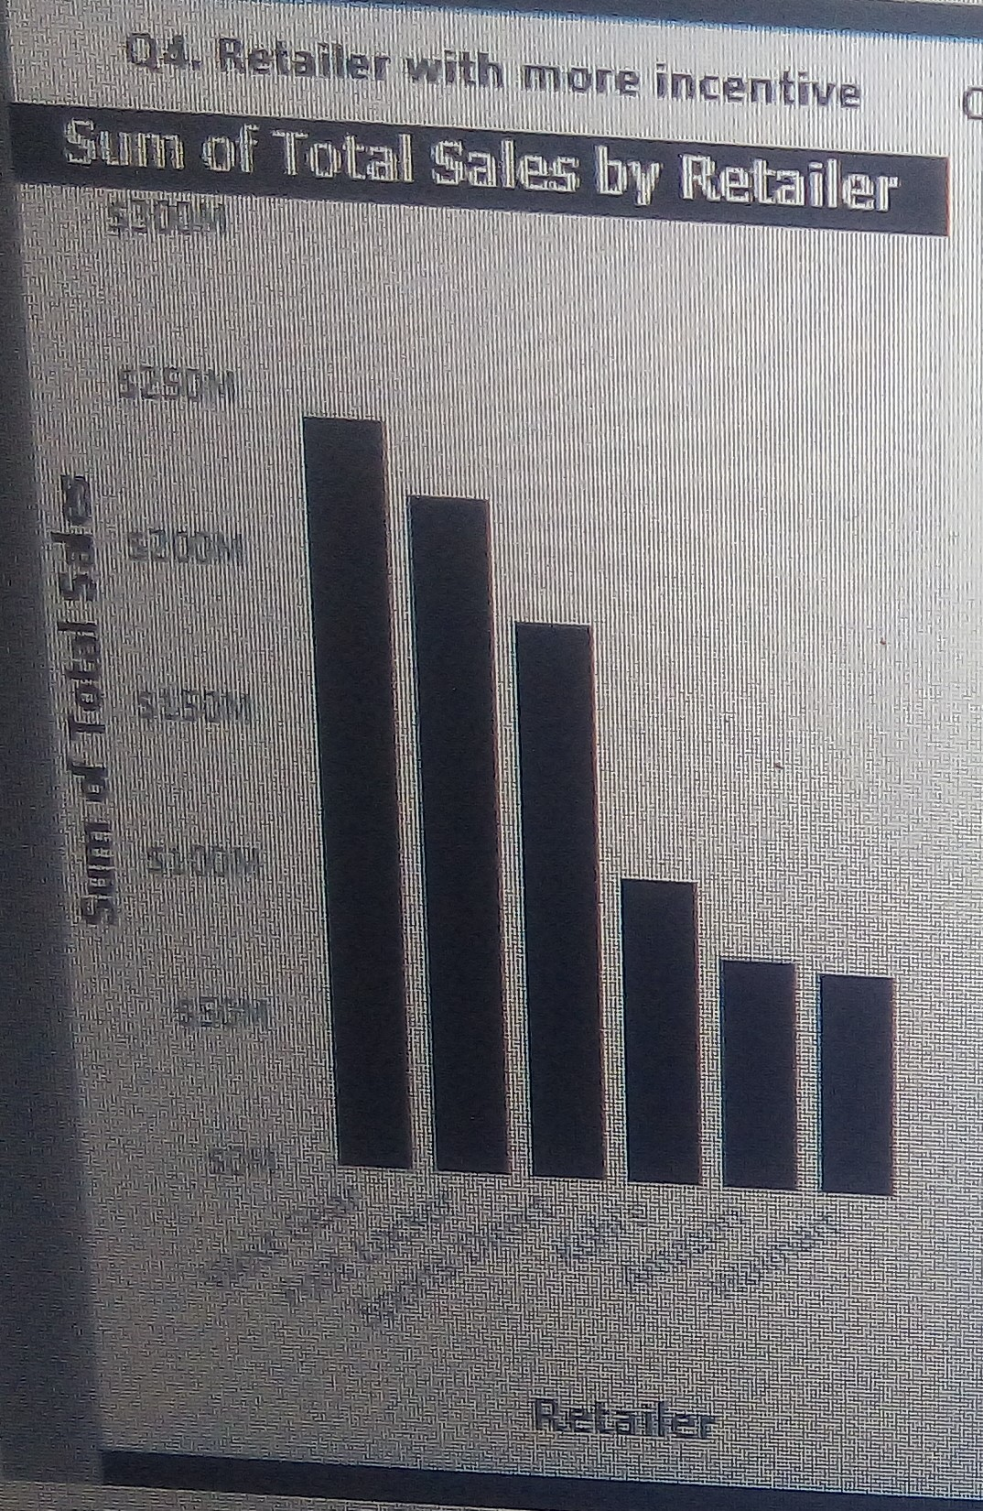
Analysis and Dashboards
Section 4:
Which retailer should we give incentive more than the other
Result shows that West Gear should have more incentive than others
Done and Presented by: Ekpendu Franca

Slide 10
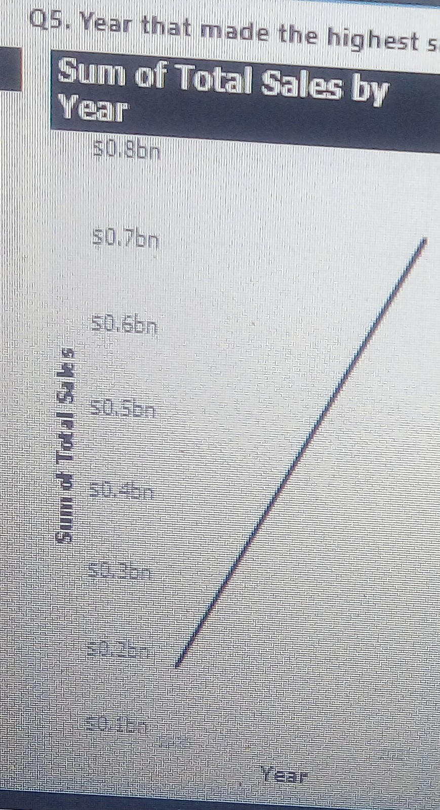
Analysis and Dashboards
Which year did we make the highest sales and why
Result shows that 2021 has the highest sales.
Because there are much or different gateways to connect to the customers to showcase their products and services and drive conversion
Section 5:
Done and Presented by: Ekpendu Franca

Slide 11
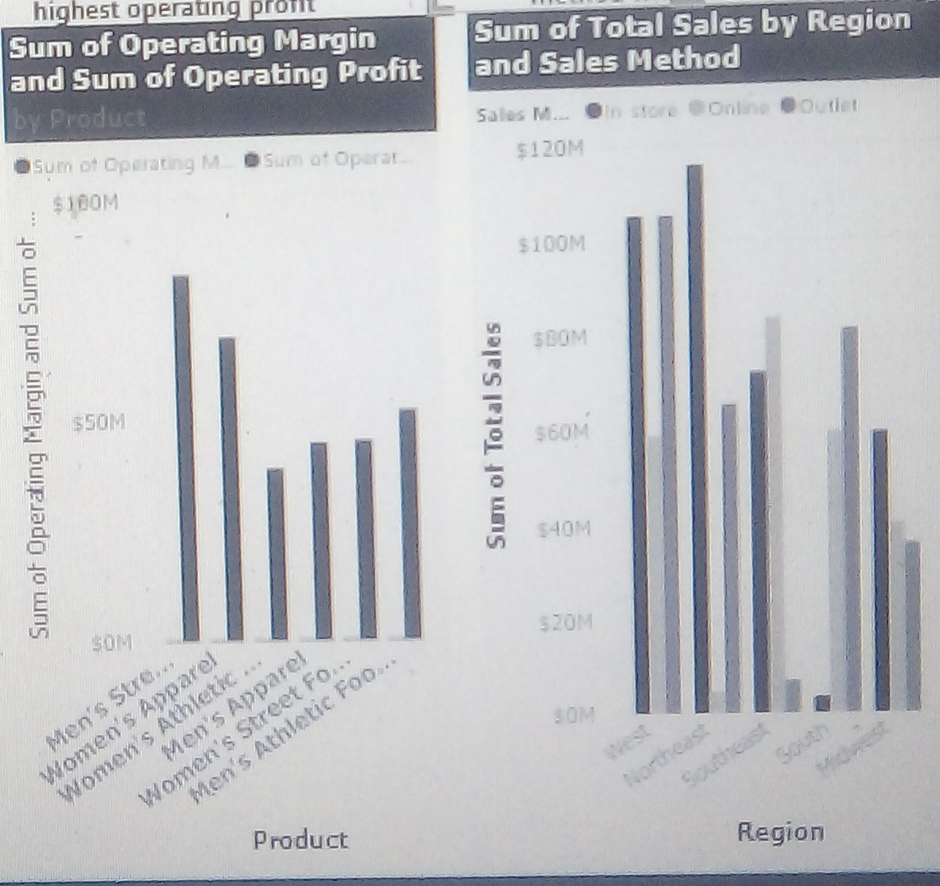
Analysis and Dashboards
Which operating margin provides the highest operating profit
What was the highest sales method and their top regions
Analysis shows that men’s street footwear operating margin provides highest operating profit while the highest sale method is In-store which Northeast and West was it top regions.
Section 6:
Done and Presented by: Ekpendu Franca

Slide 12
Conclusion/Recommendations
Conclusion:
Based on my analytical skills, I observed that the these seven (7)objectives or insights play a key role in enhancing the company growth and its revenue.
Recommendations:
The company should keep producing the products especially Men’s street footwear that boost the company revenue and the company should also come up with more gateways or strategies, methods to reach the heart of their customers.
Done and Presented by: Ekpendu Franca

Slide 13
THANK YOU ASK ME ANY QUESTION
Done and Presented by: Ekpendu Franca

